Slide 1
Experimental Design – and similarly for MK2206
 |  | Time (h)
Condition Code | Condition | 0.00 | 24.00 | 48.00 | 70.25 | 70.75 | 71.25 | 72.00
D | DMSO | Add DMSO | - | - | Starve | - | - | Lysis
T | TGFb | Add DMSO | - | - | Starve | - | TGFb Treatment | Lysis
E | TGFb + EV | Add DMSO and EV | - | - | Starve | - | TGFb Treatment | Lysis
E_A_72 | TGFB + Everolimus+ AZD 3 | Add EV and AZD | - | - | Starve | - | TGFb Treatment | Lysis
E_A_48 | TGFB + Everolimus+ AZD | Add EV | Add AZD | - | Starve | - | TGFb Treatment | Lysis
E_A_24 | TGFB + Everolimus+ AZD 1 | Add EV | - | Add AZD | Starve | - | TGFb Treatment | Lysis
E_1.25 | TGFB + Everolimus+ AZD30 mins | Add EV | - | - | Starve | Add AZD | TGFb Treatment | Lysis
72 | TGFB + AZD 3 | Add DMSO and AZD | - | - | Starve | - | TGFb Treatment | Lysis
48 | TGFB + AZD 2 | Add DMSO | Add AZD | - | Starve | - | TGFb Treatment | Lysis
48 | TGFB + AZD 1 | Add DMSO | - | Add AZD | Starve | - | TGFb Treatment | Lysis
A_1.25 | TGFB + AZD 30mins | Add DMSO | - | - | Starve | Add AZD | TGFb Treatment | Lysis

Slide 2
Event based modelling
Will hopefully allow us to map the experimental protocol directly onto model
I don’t think the previous strategy of starting the simulation with the various initial conditions mapped the simulation variables correctly onto the experimental variables
Previously (as I recall), the simulation started with TGFb in all conditions whereas in reality, TGFb is only used at 71.25h after the first pretreatment.
Previously, we set the initial conditions and allowed the simulation to progress, using the 24, 48 and 72h as read out times. This neglects the stimulation part of the protocol (i.e. TGFb stimulation at t=71.25h = -45min)
An alternative strategy is to use events to reproduce the experimental protocol exactly

Slide 3
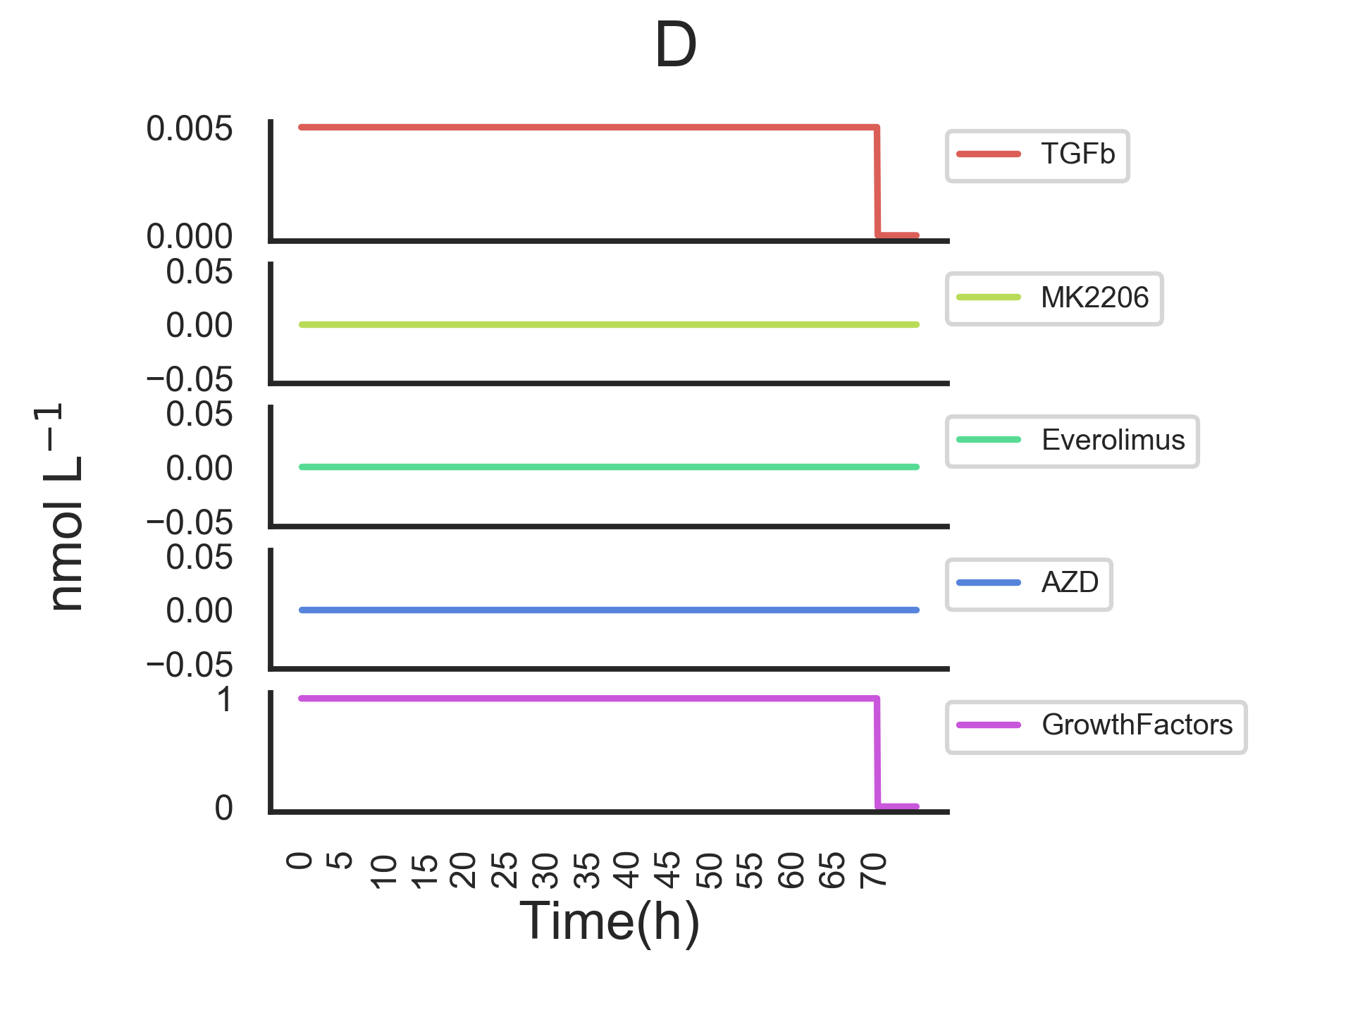
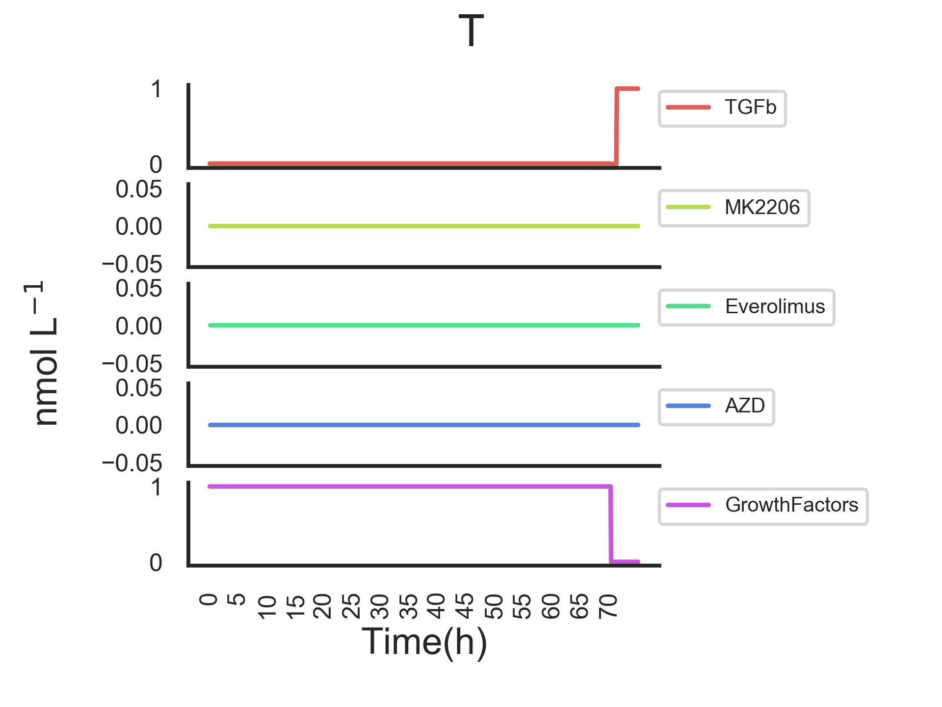
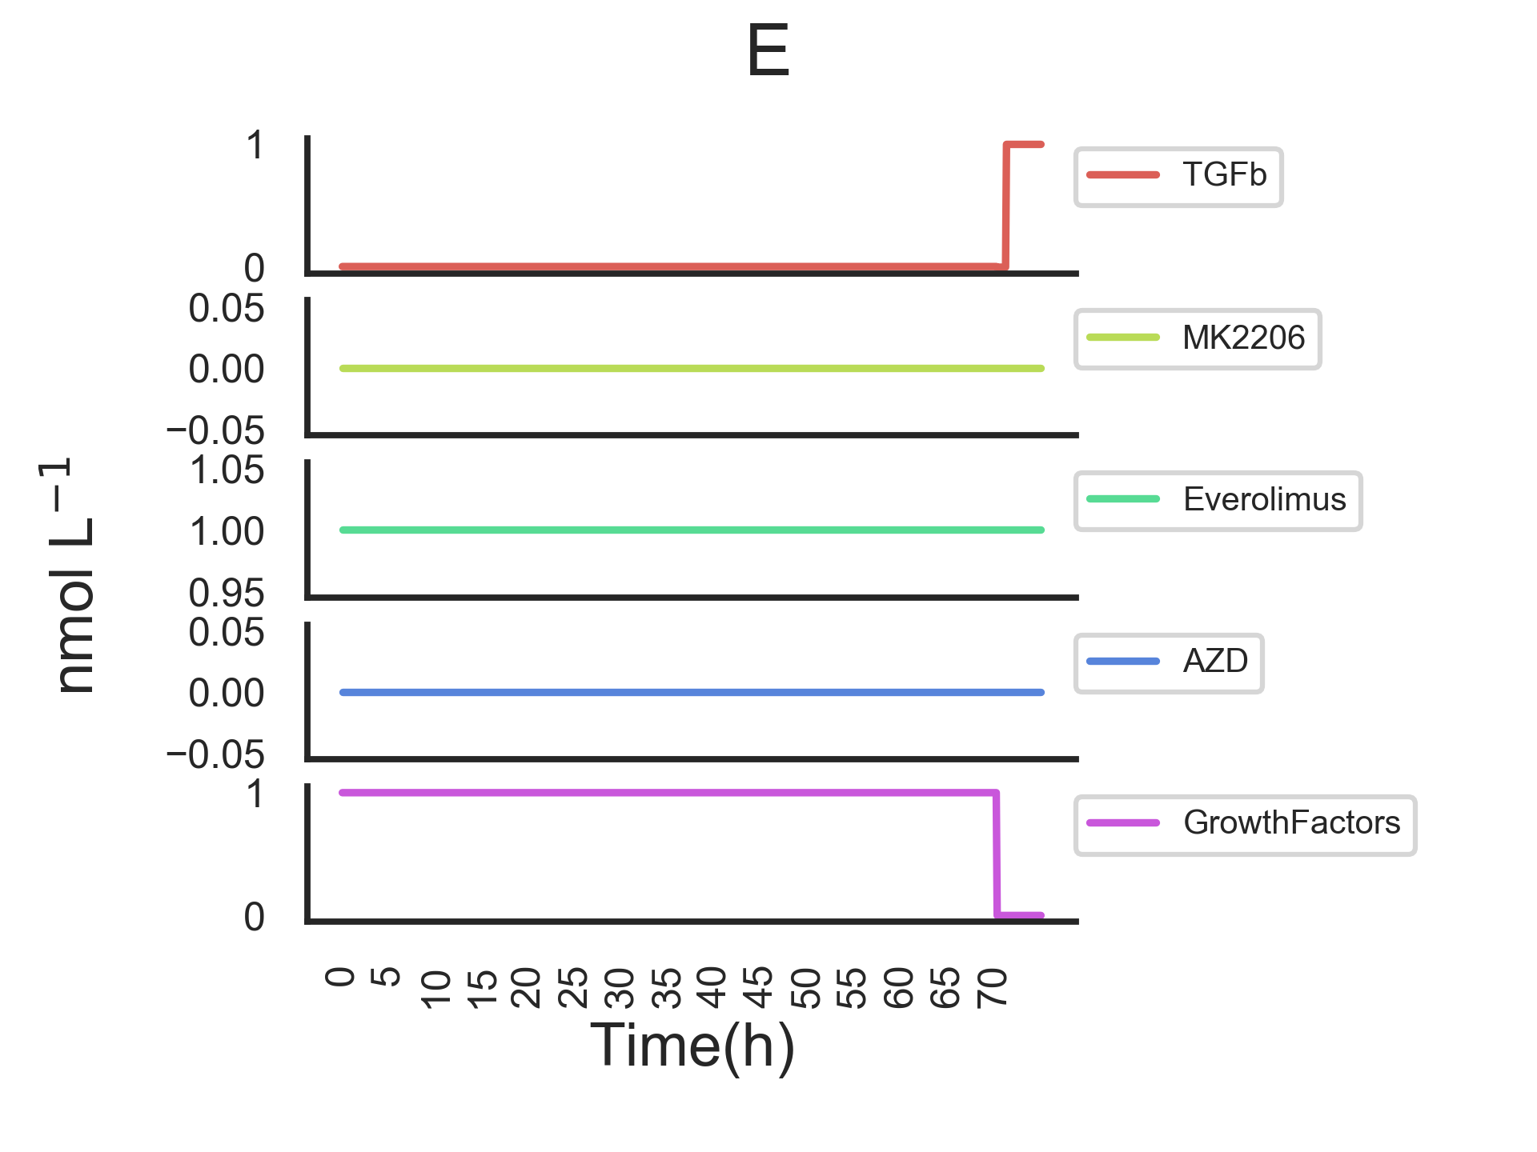
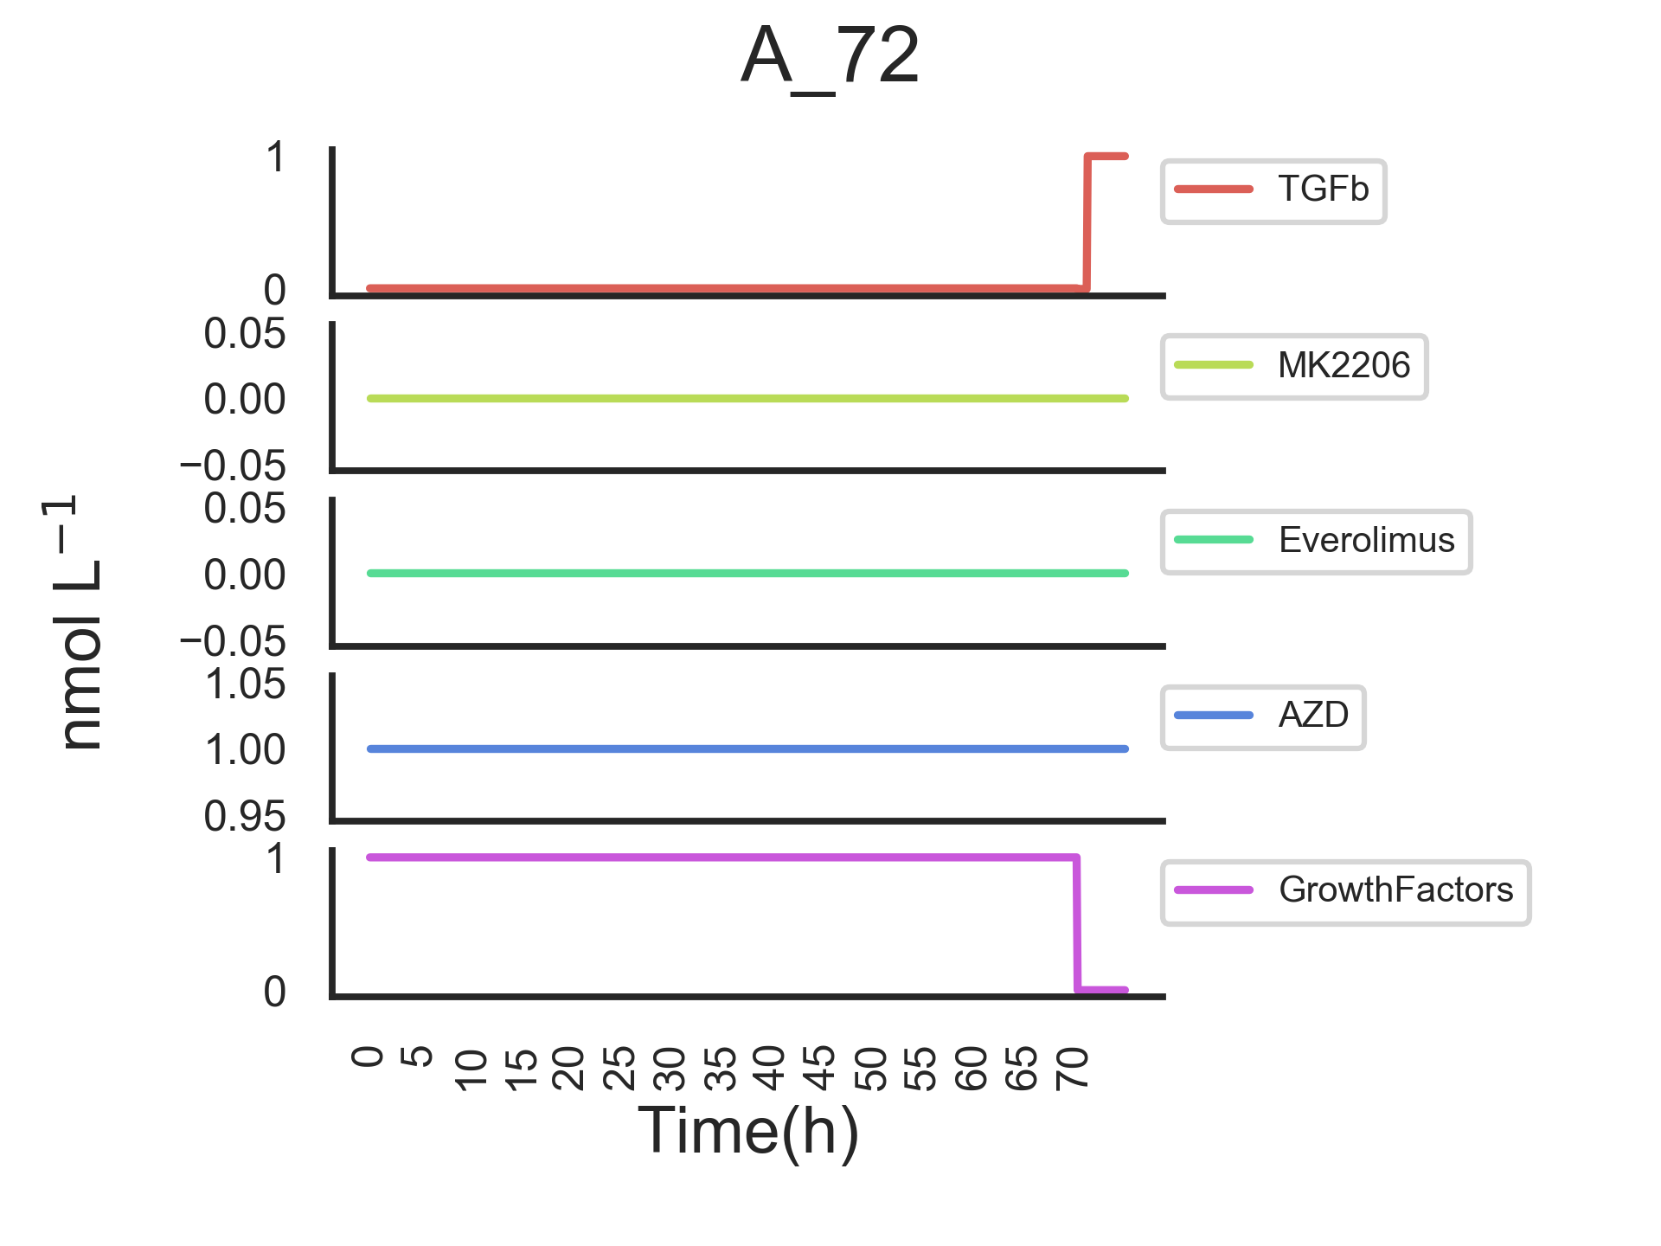
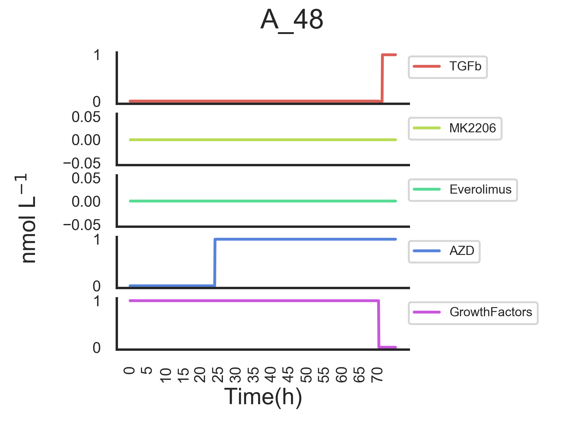
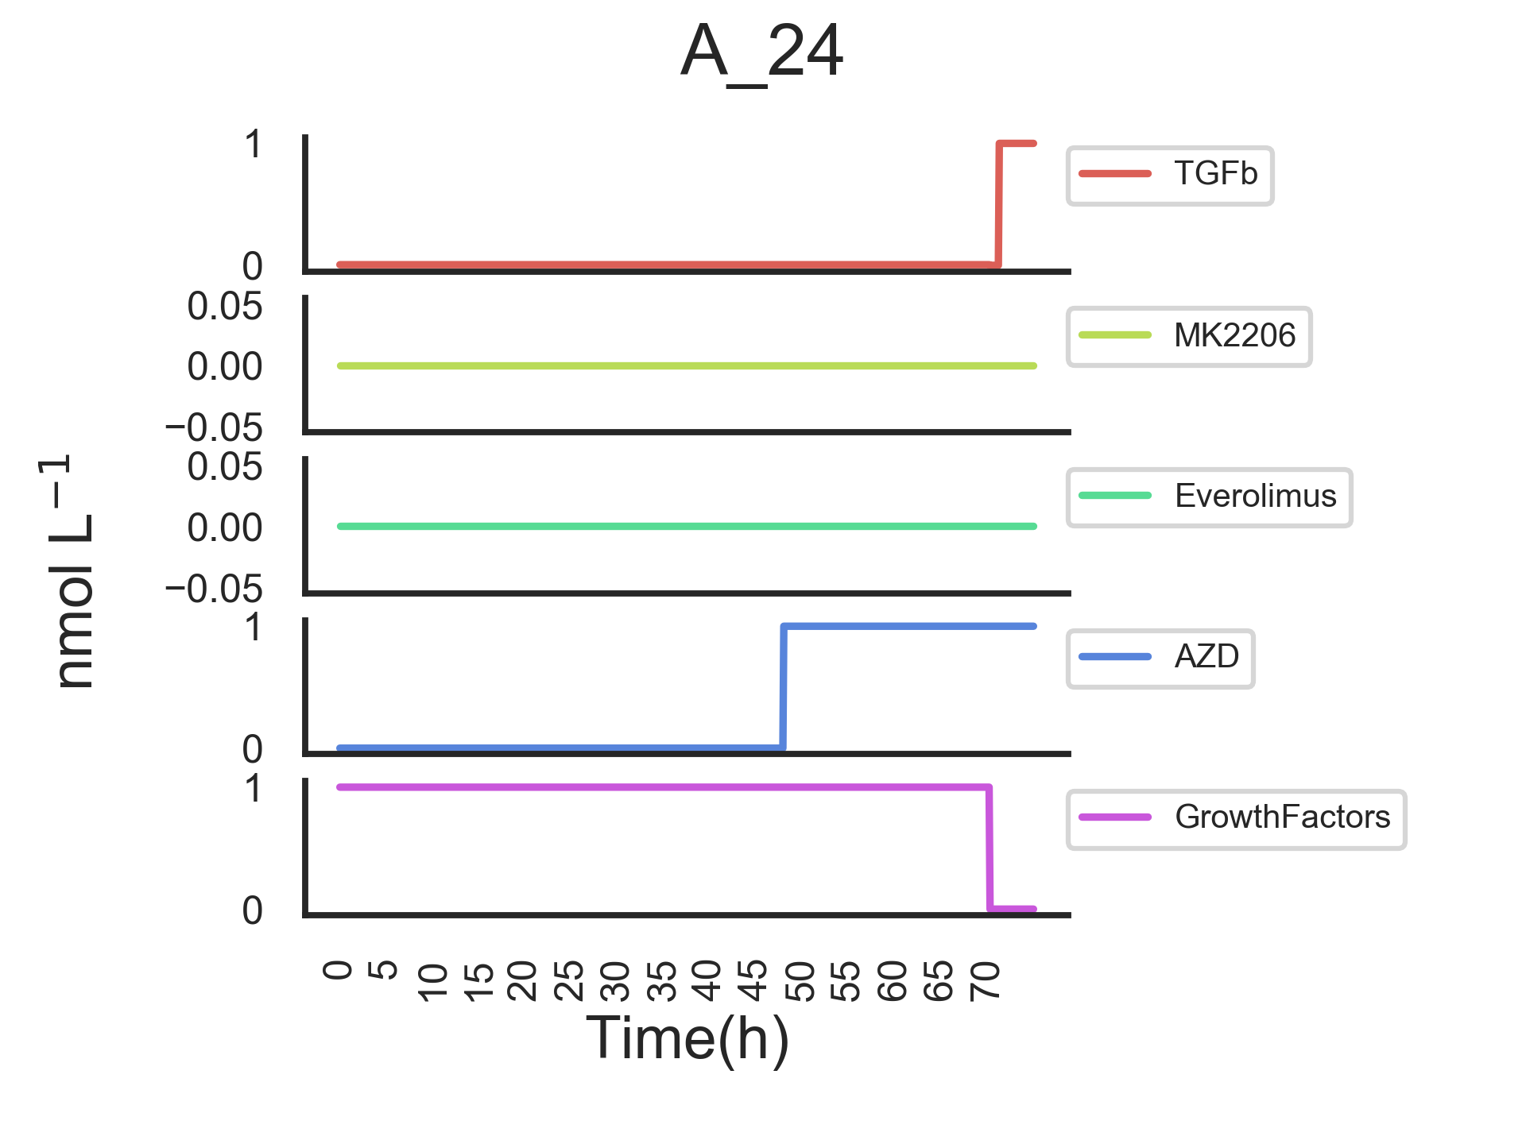
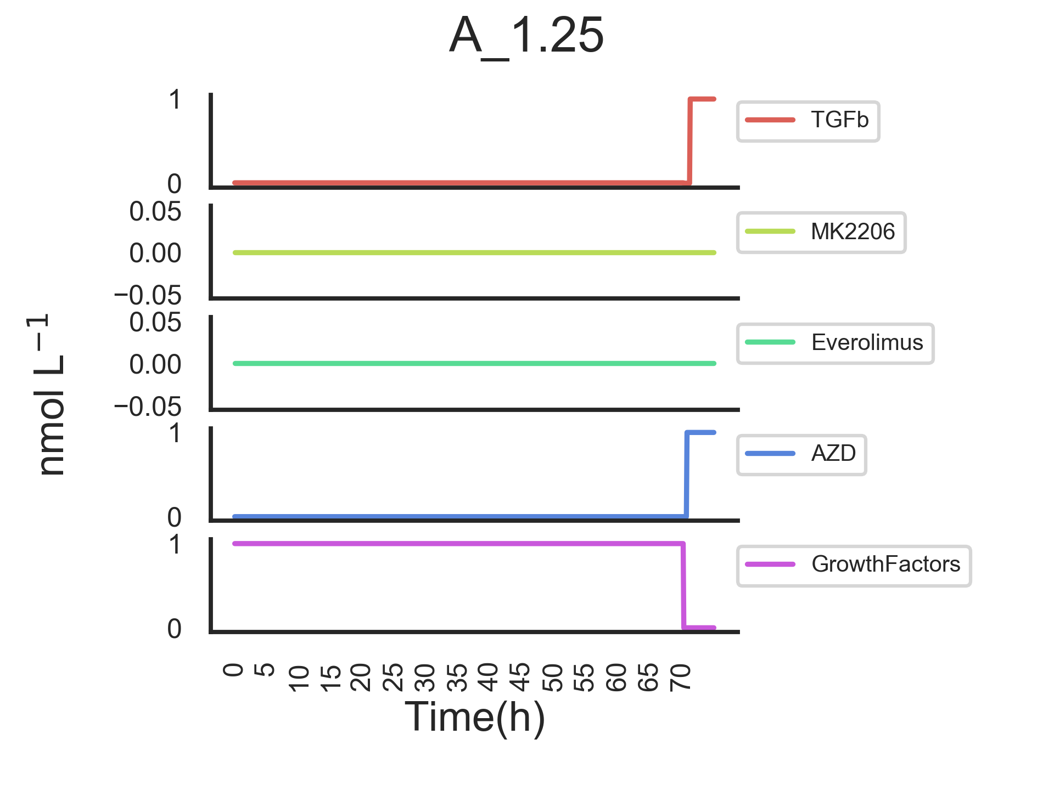

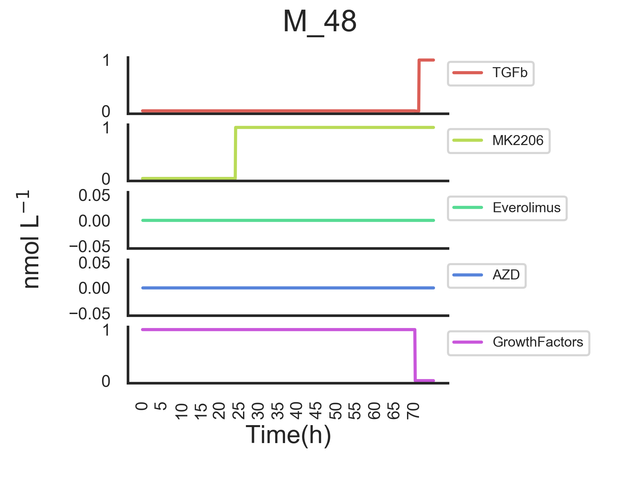
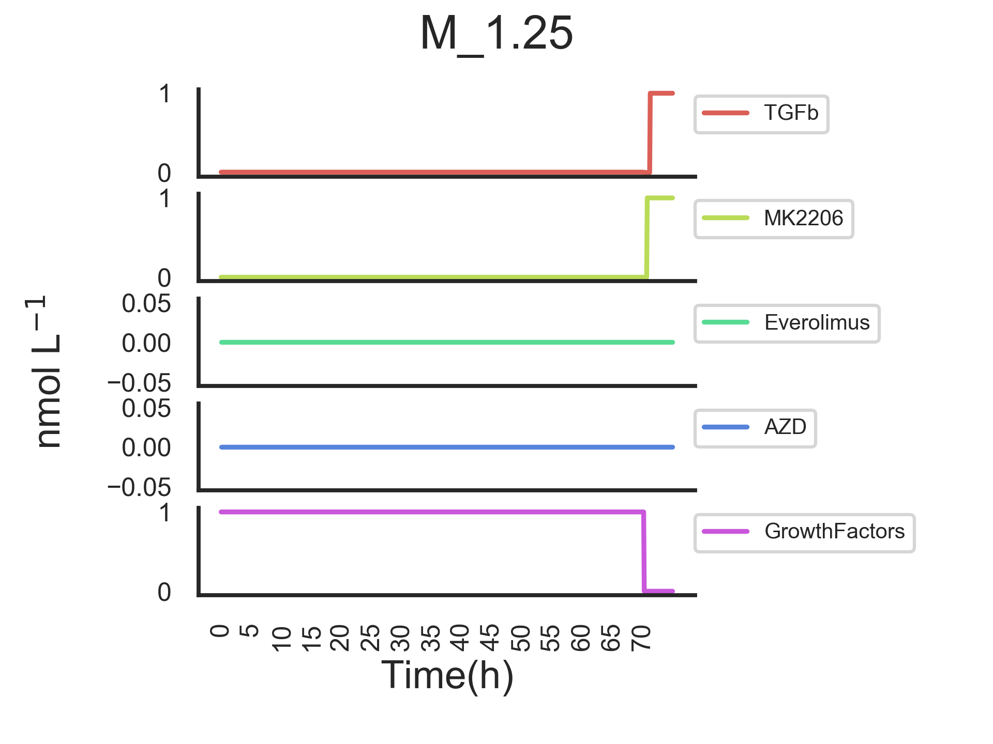
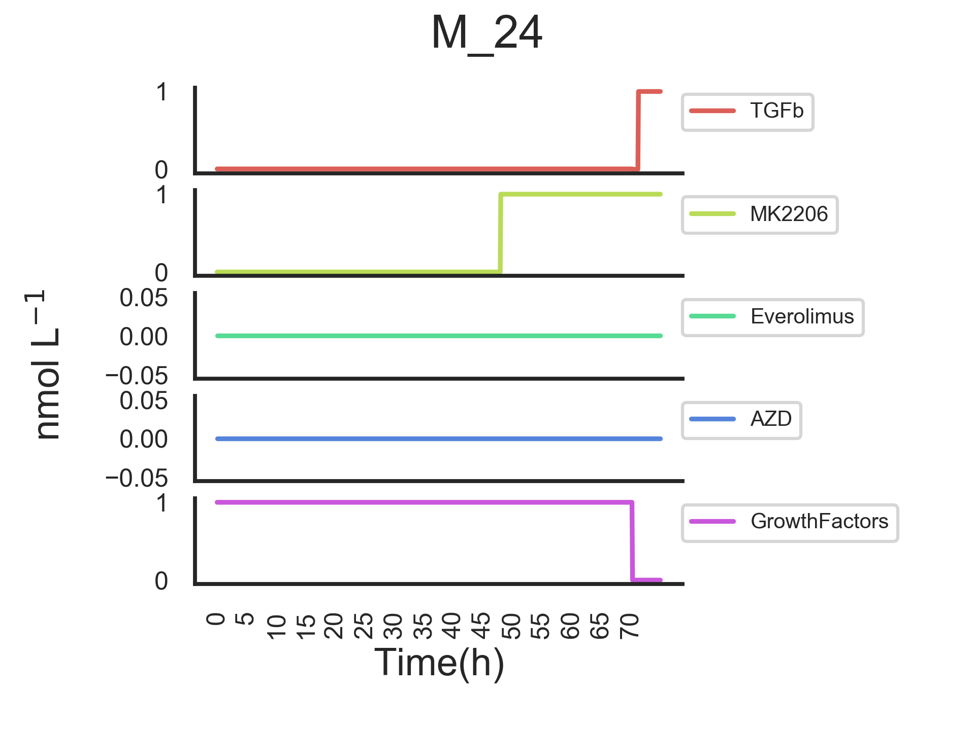
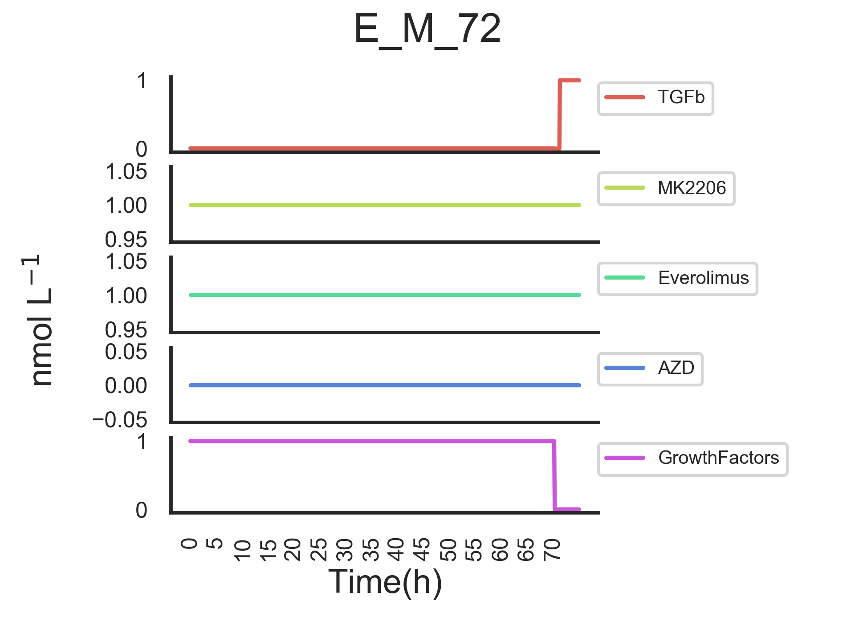




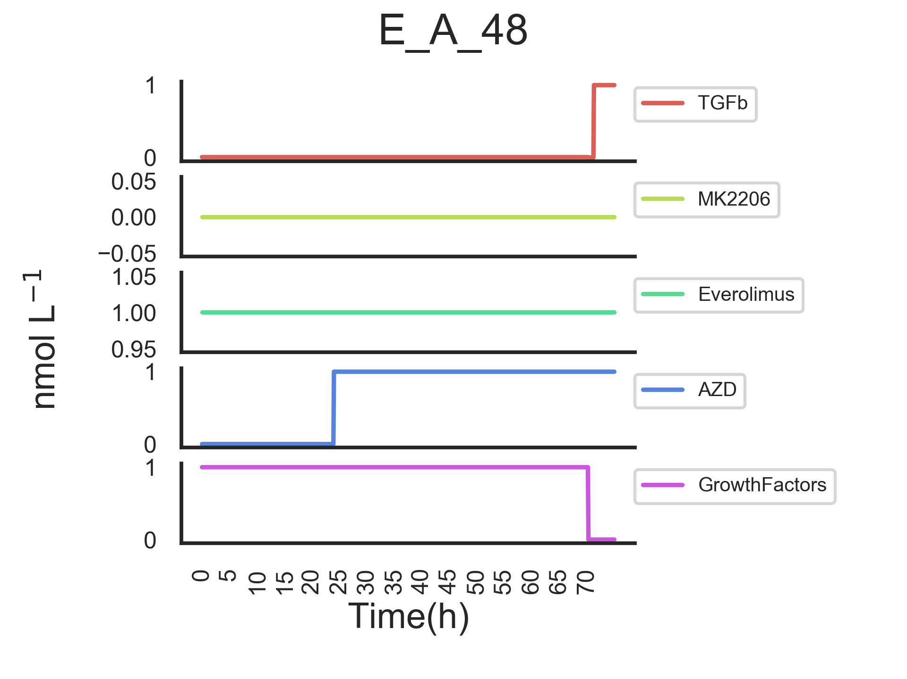
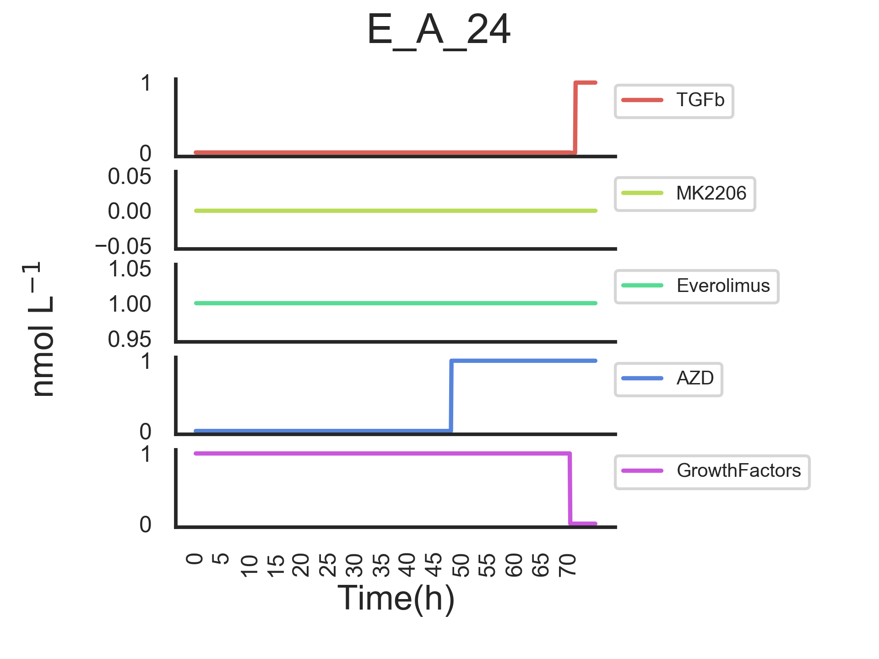
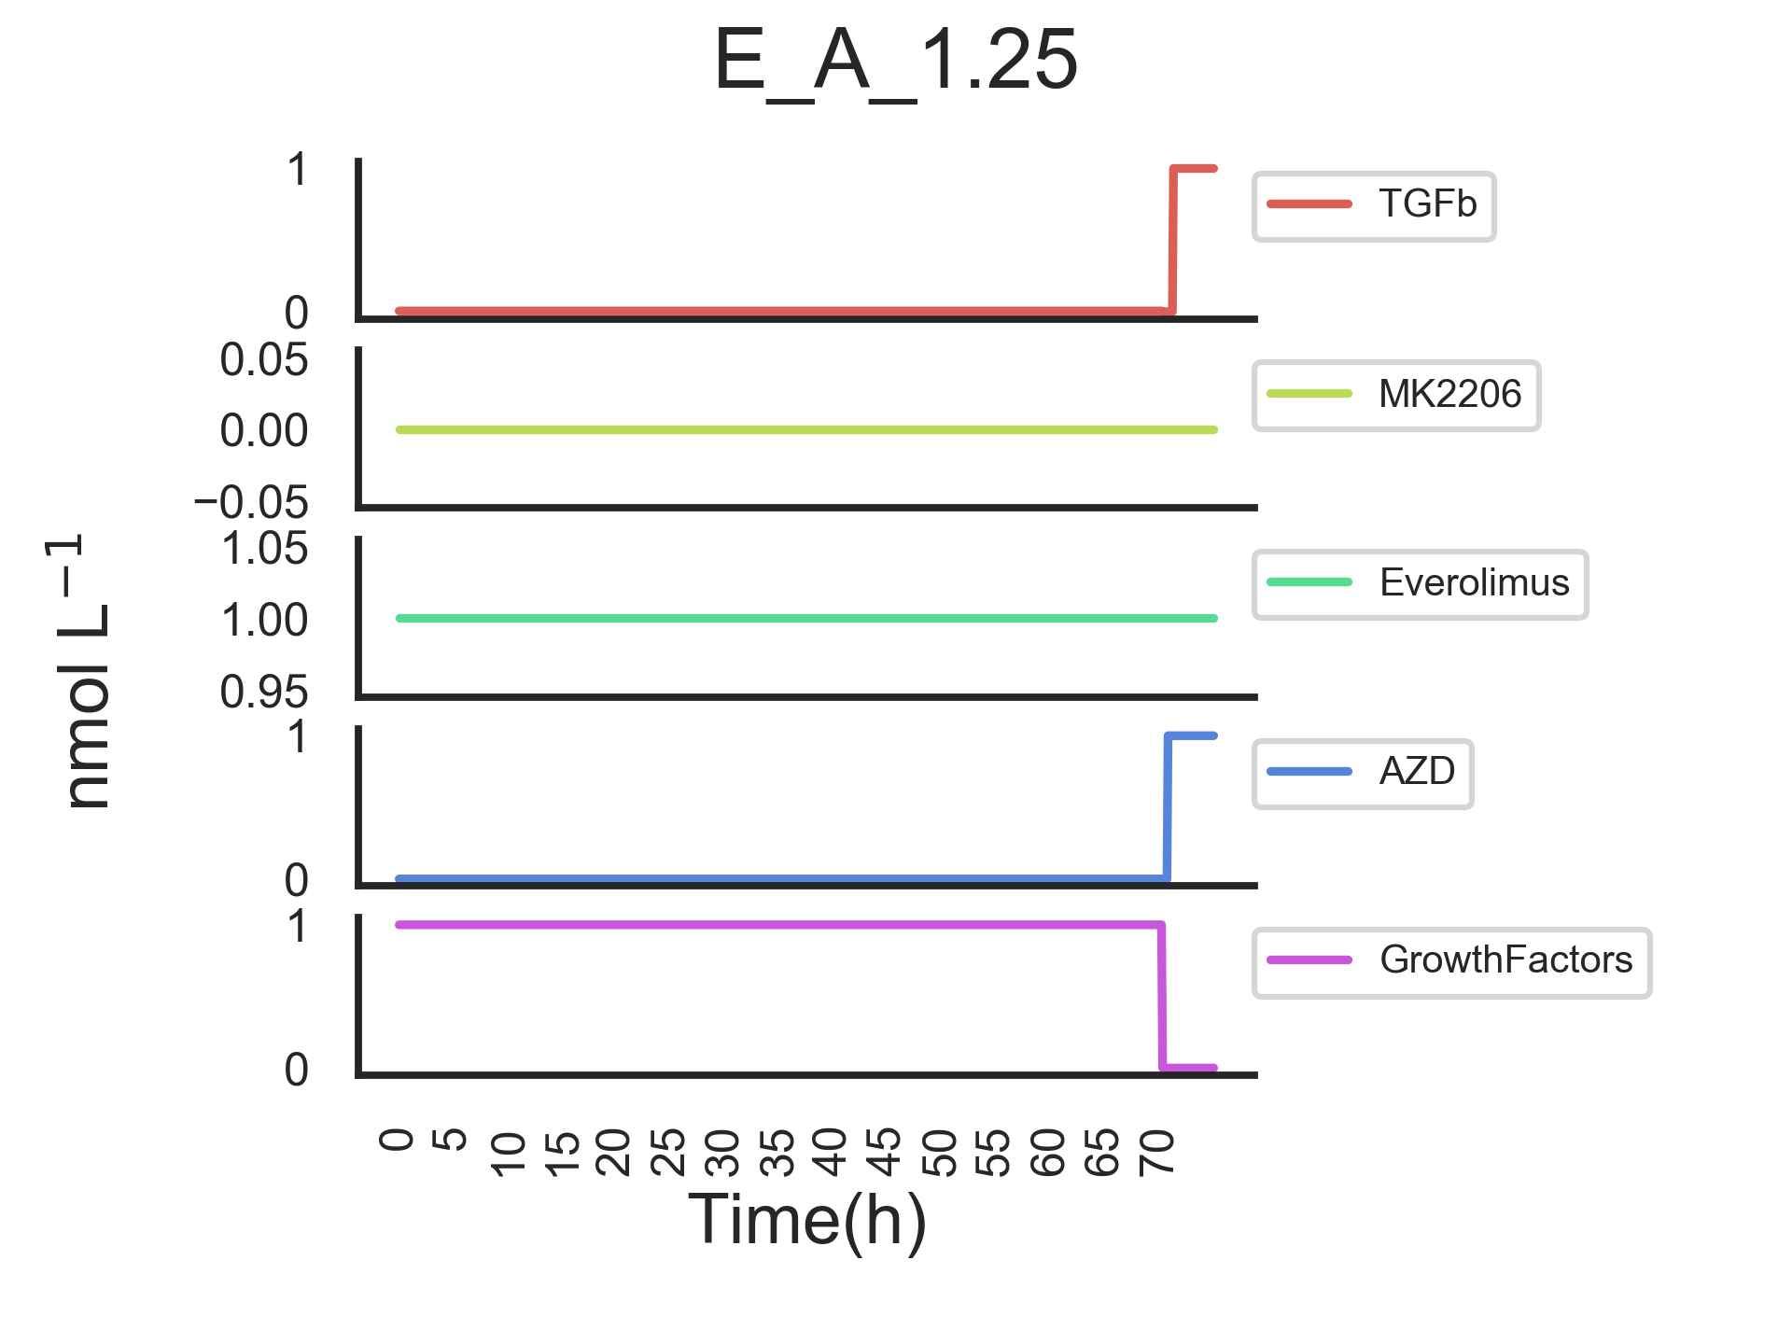
Modelling inputs

Slide 4
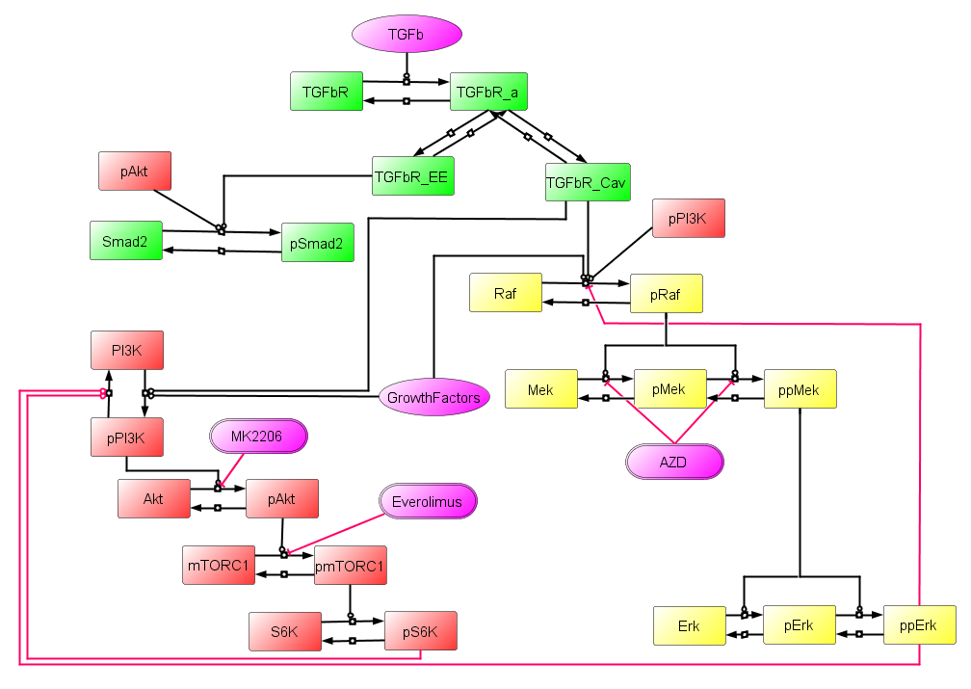
Topology 2
Weak link between pAkt and mTOR
Put TSCs back in.
- These cells have a TSC mutation
Renders TSC complex less active

Slide 5
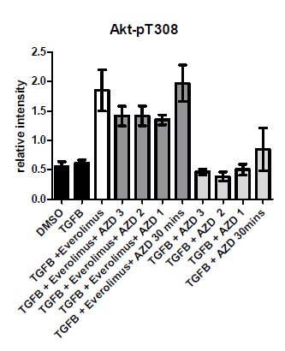
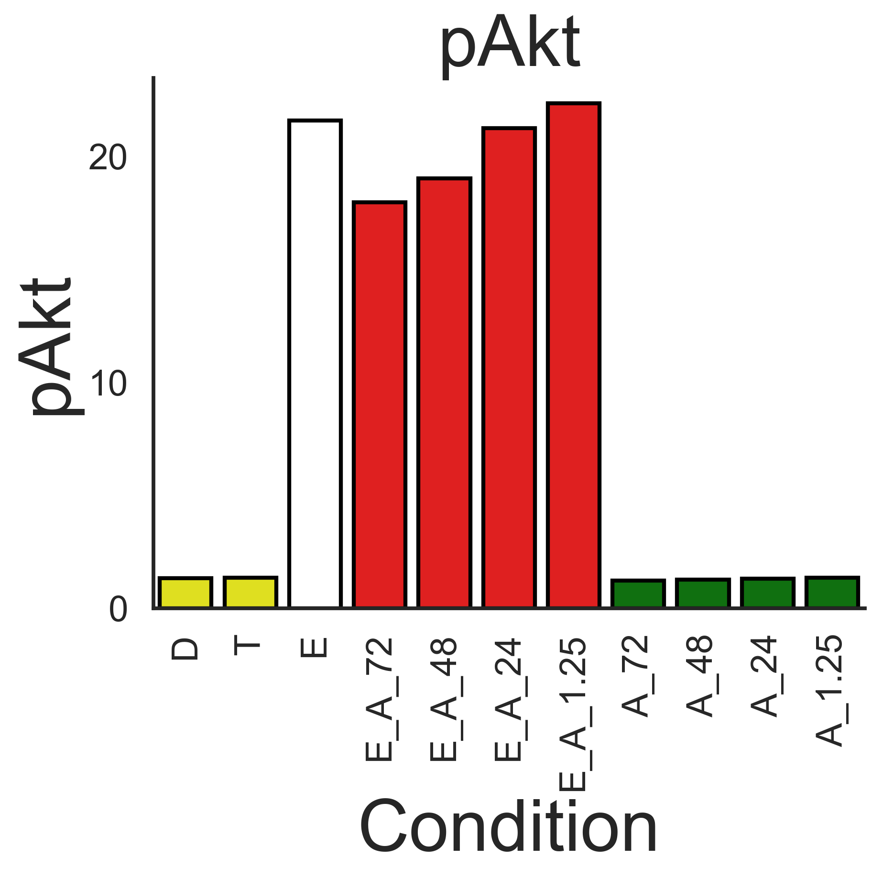
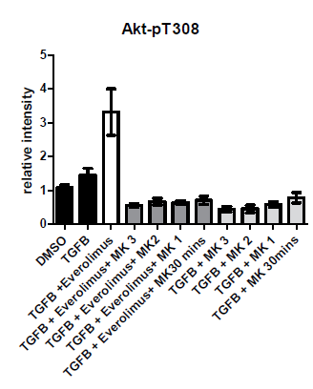
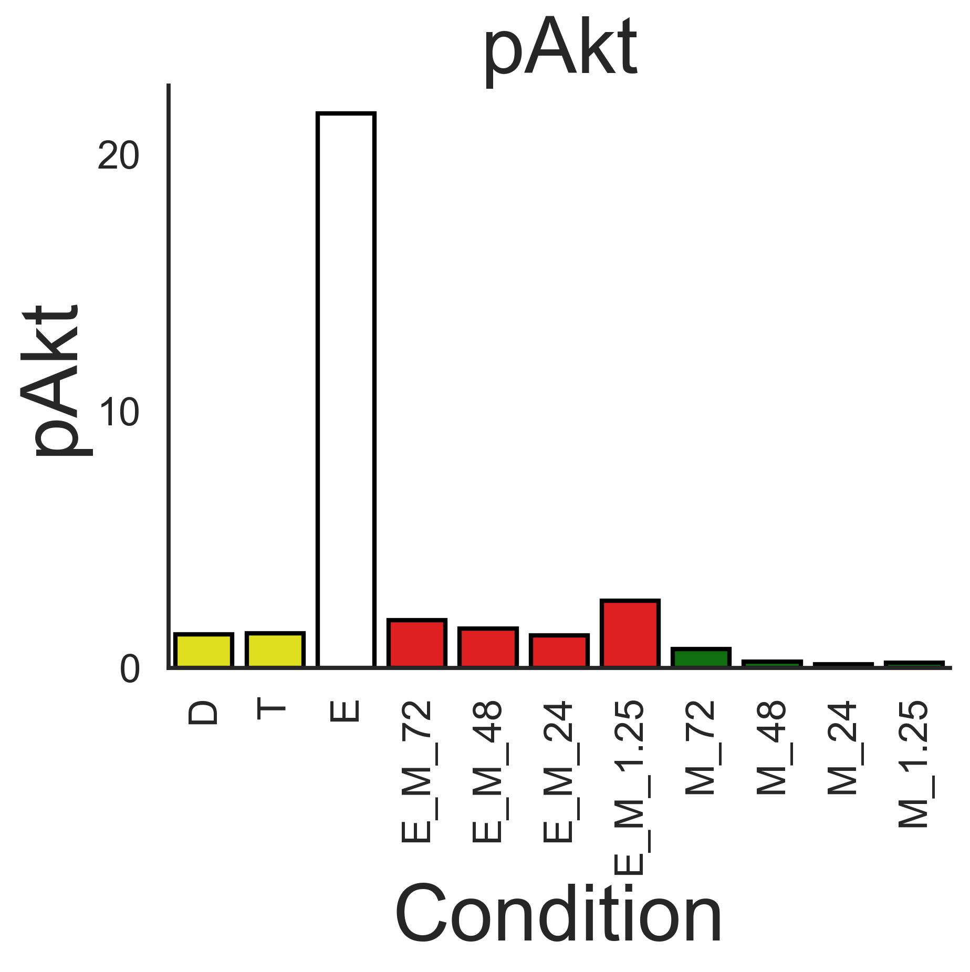
pAkt
Experimental
Simulation
AZD
MK2206

Slide 6
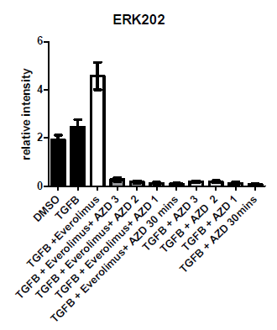
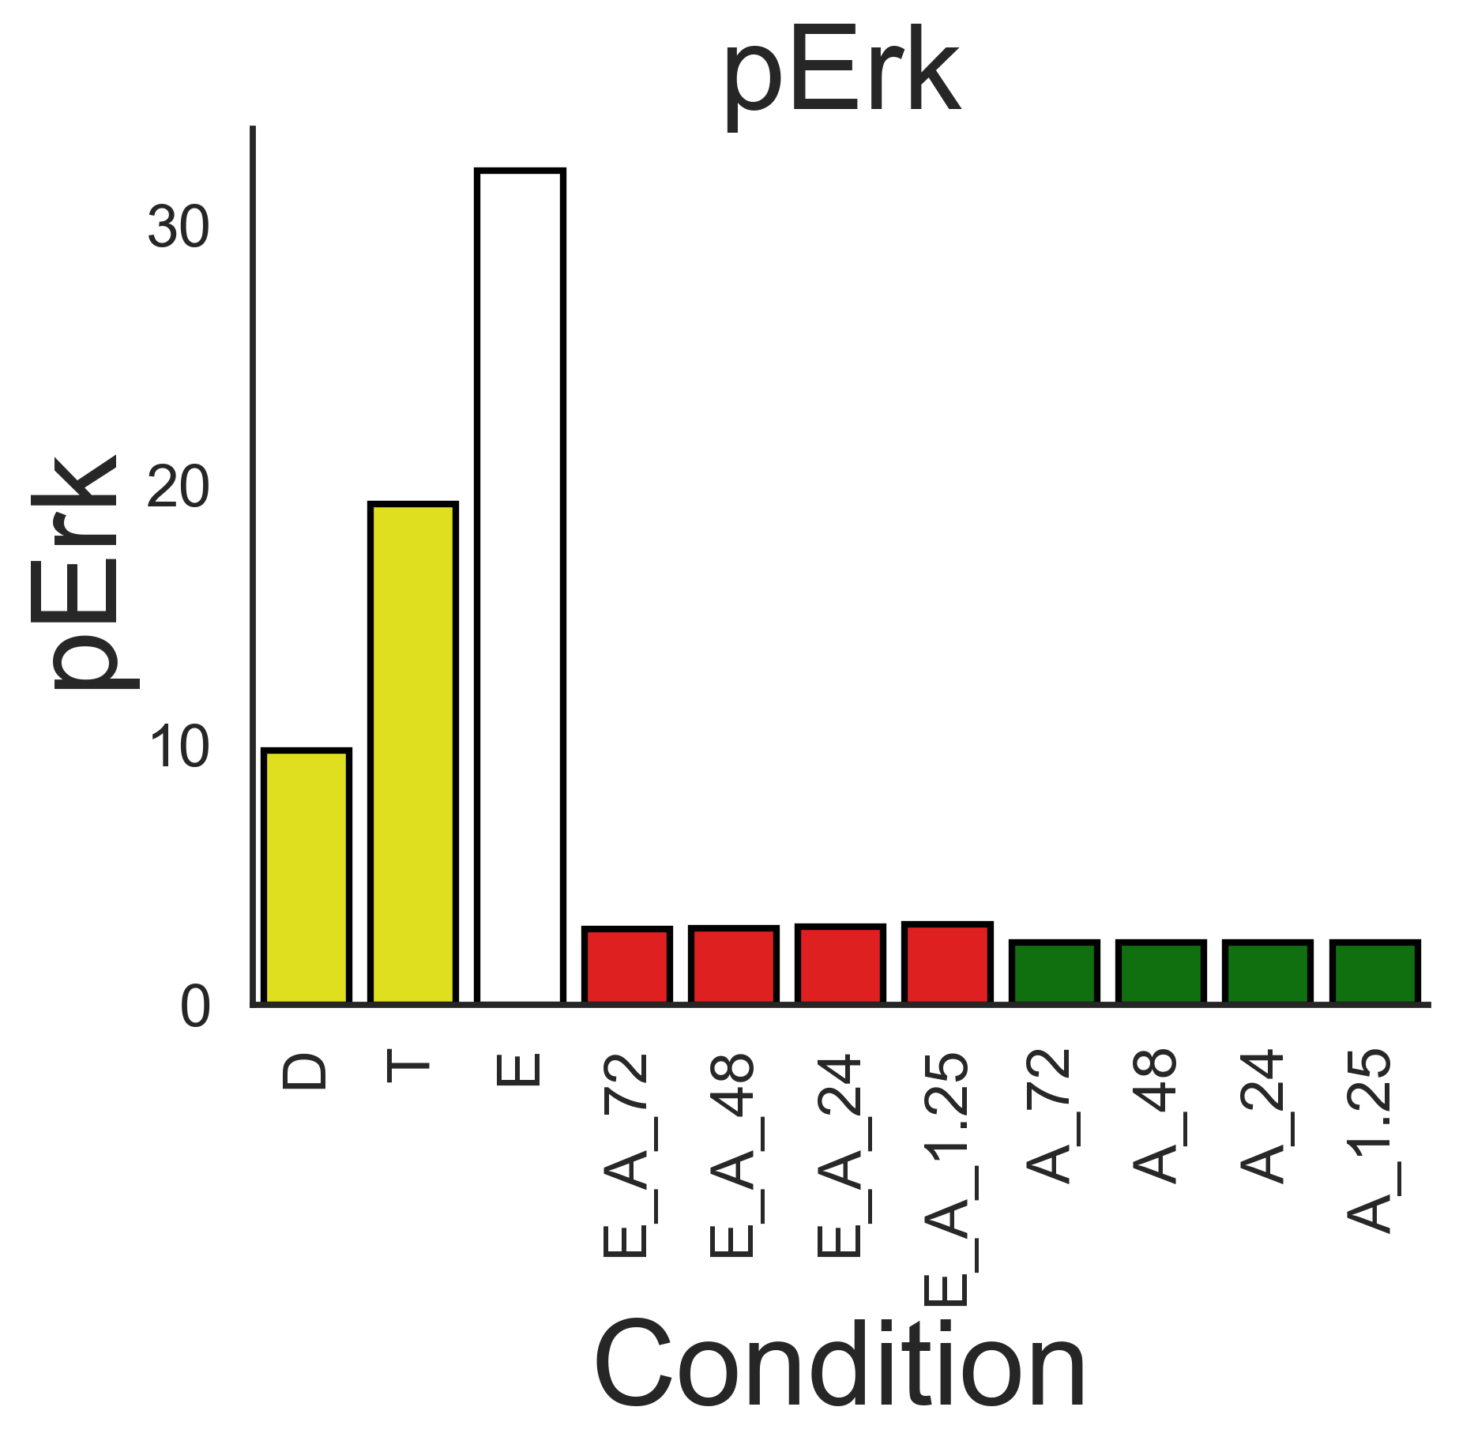
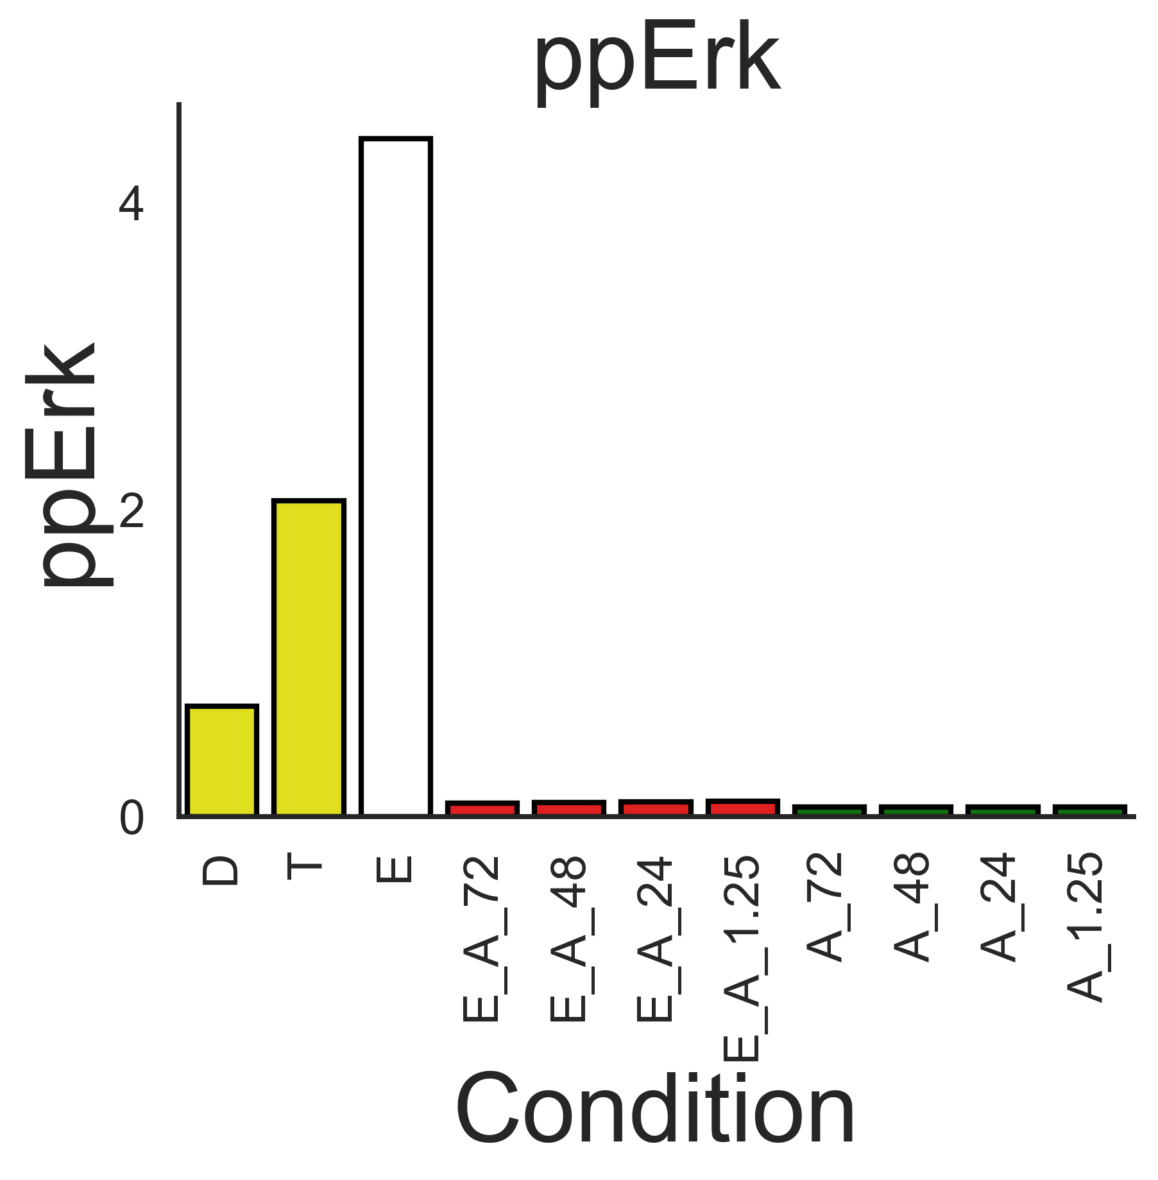
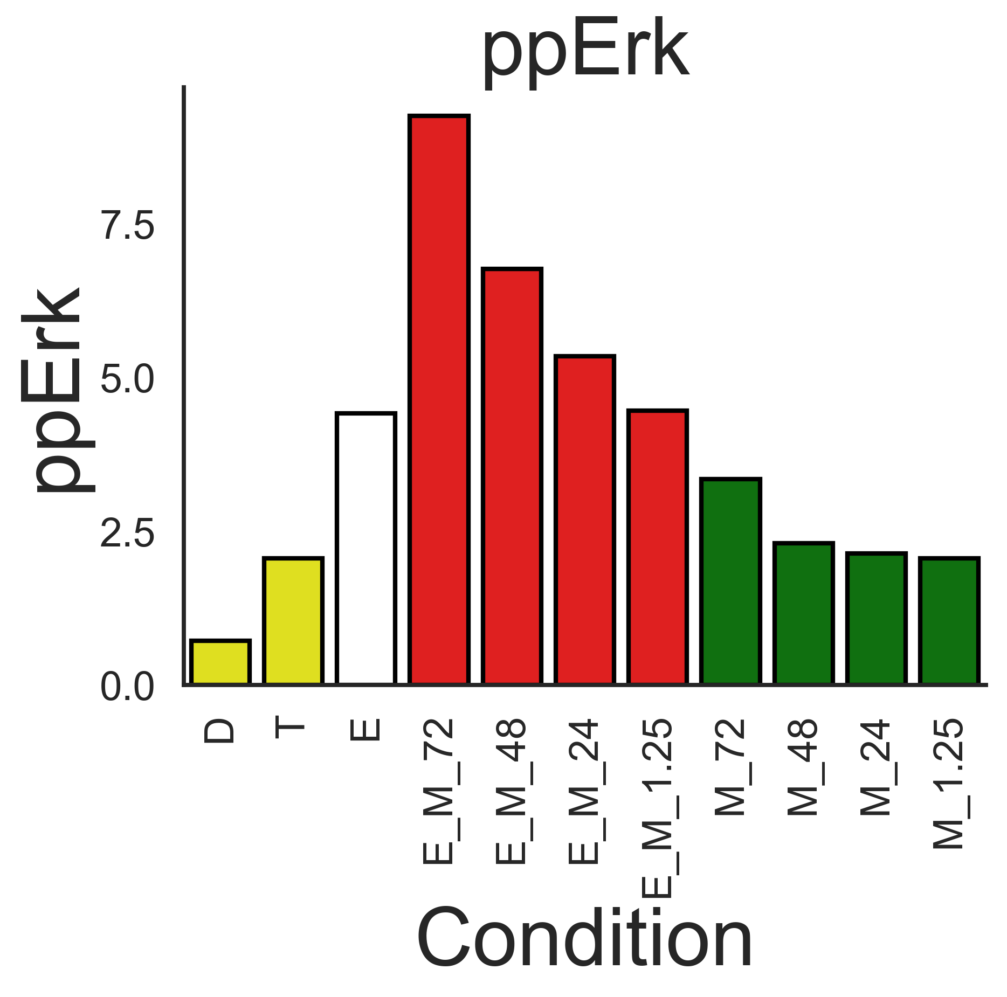
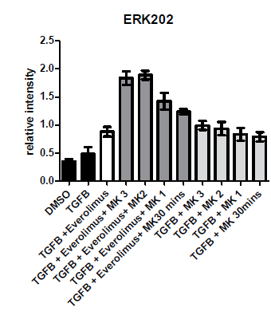
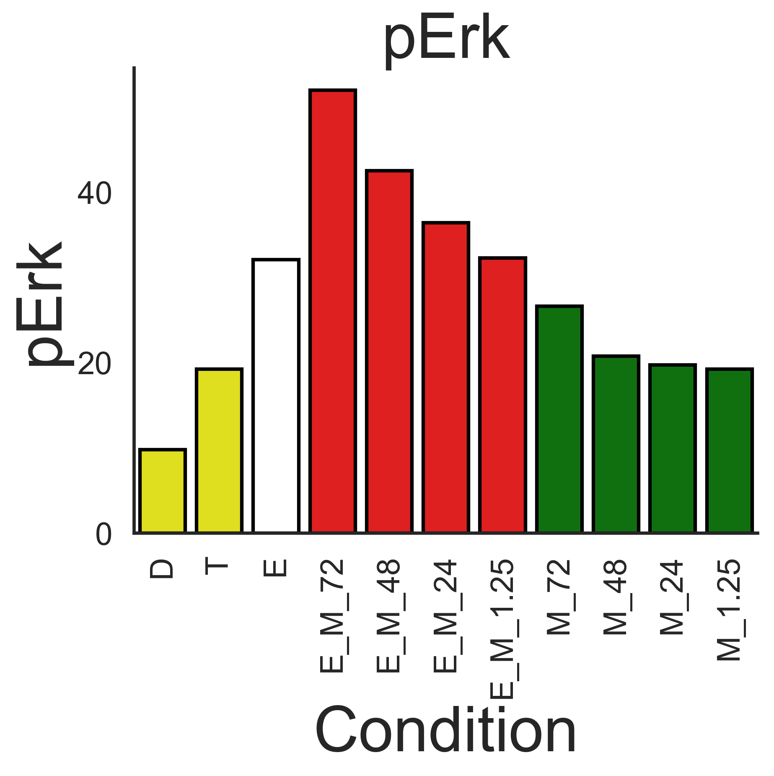
pErk / ppErk
Experimental
Simulation
AZD
MK2206

Slide 7
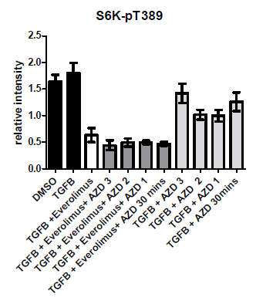
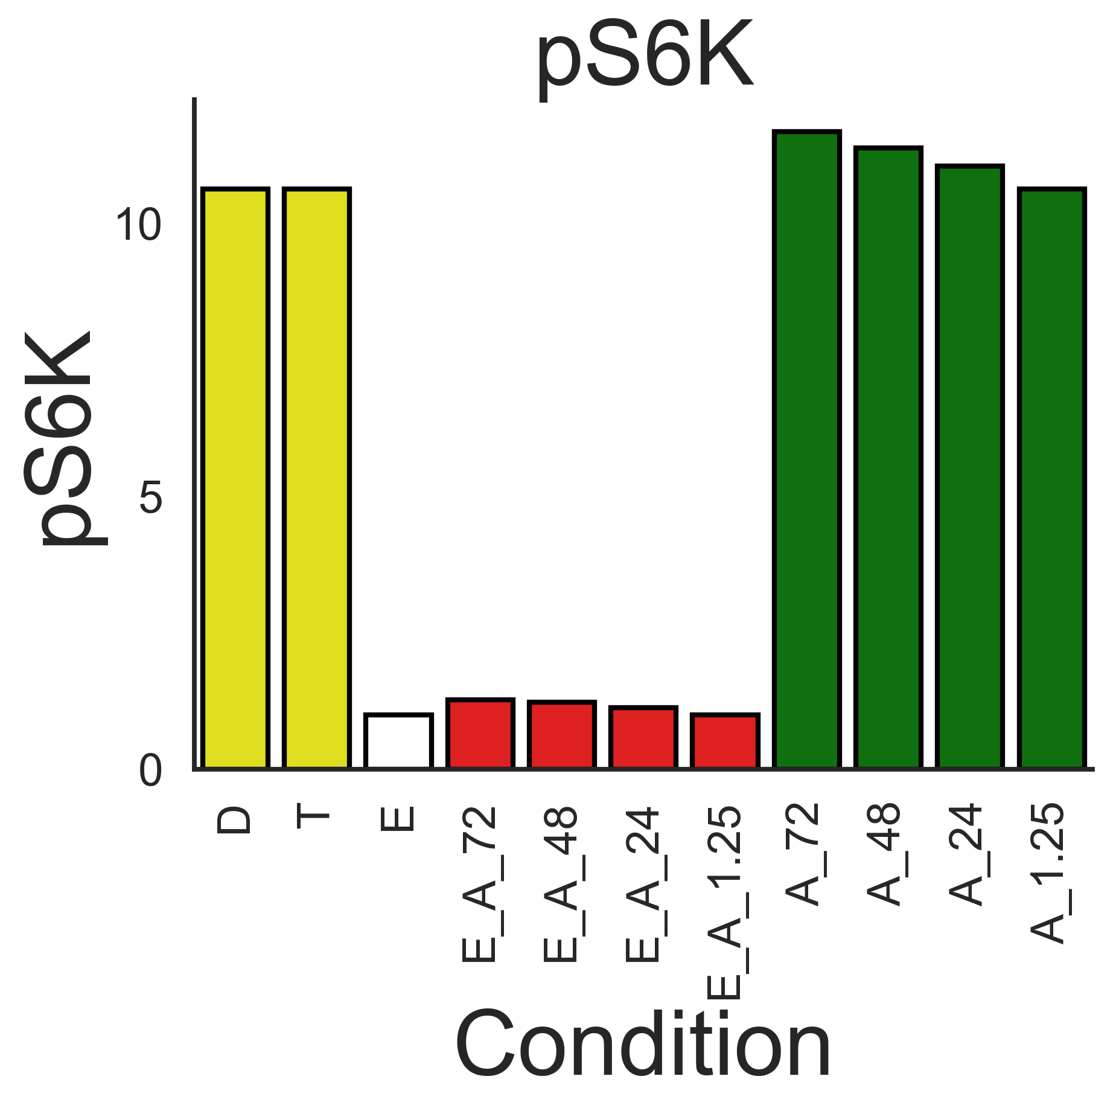
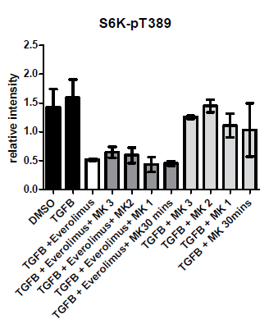
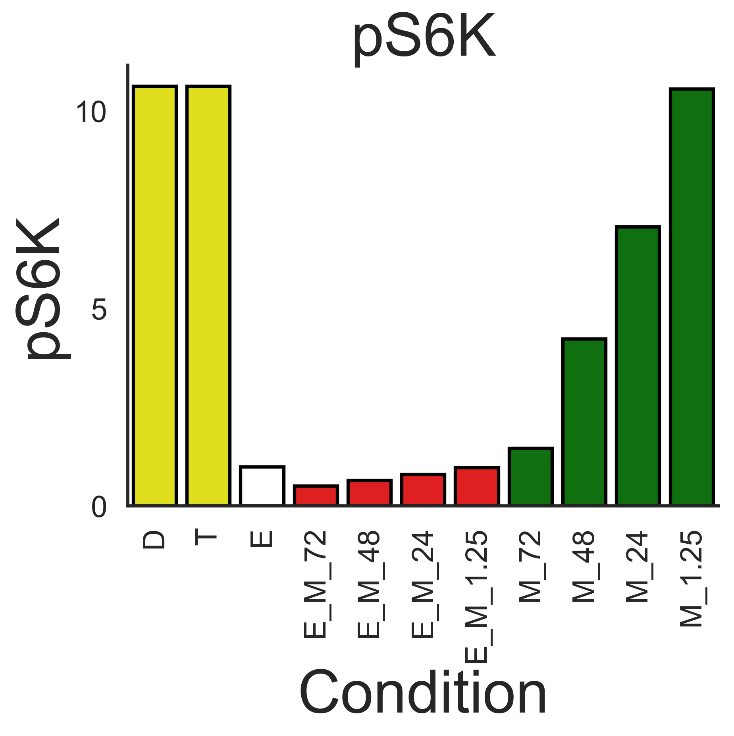
pS6K
Experimental
Simulation
AZD
MK2206

Slide 8
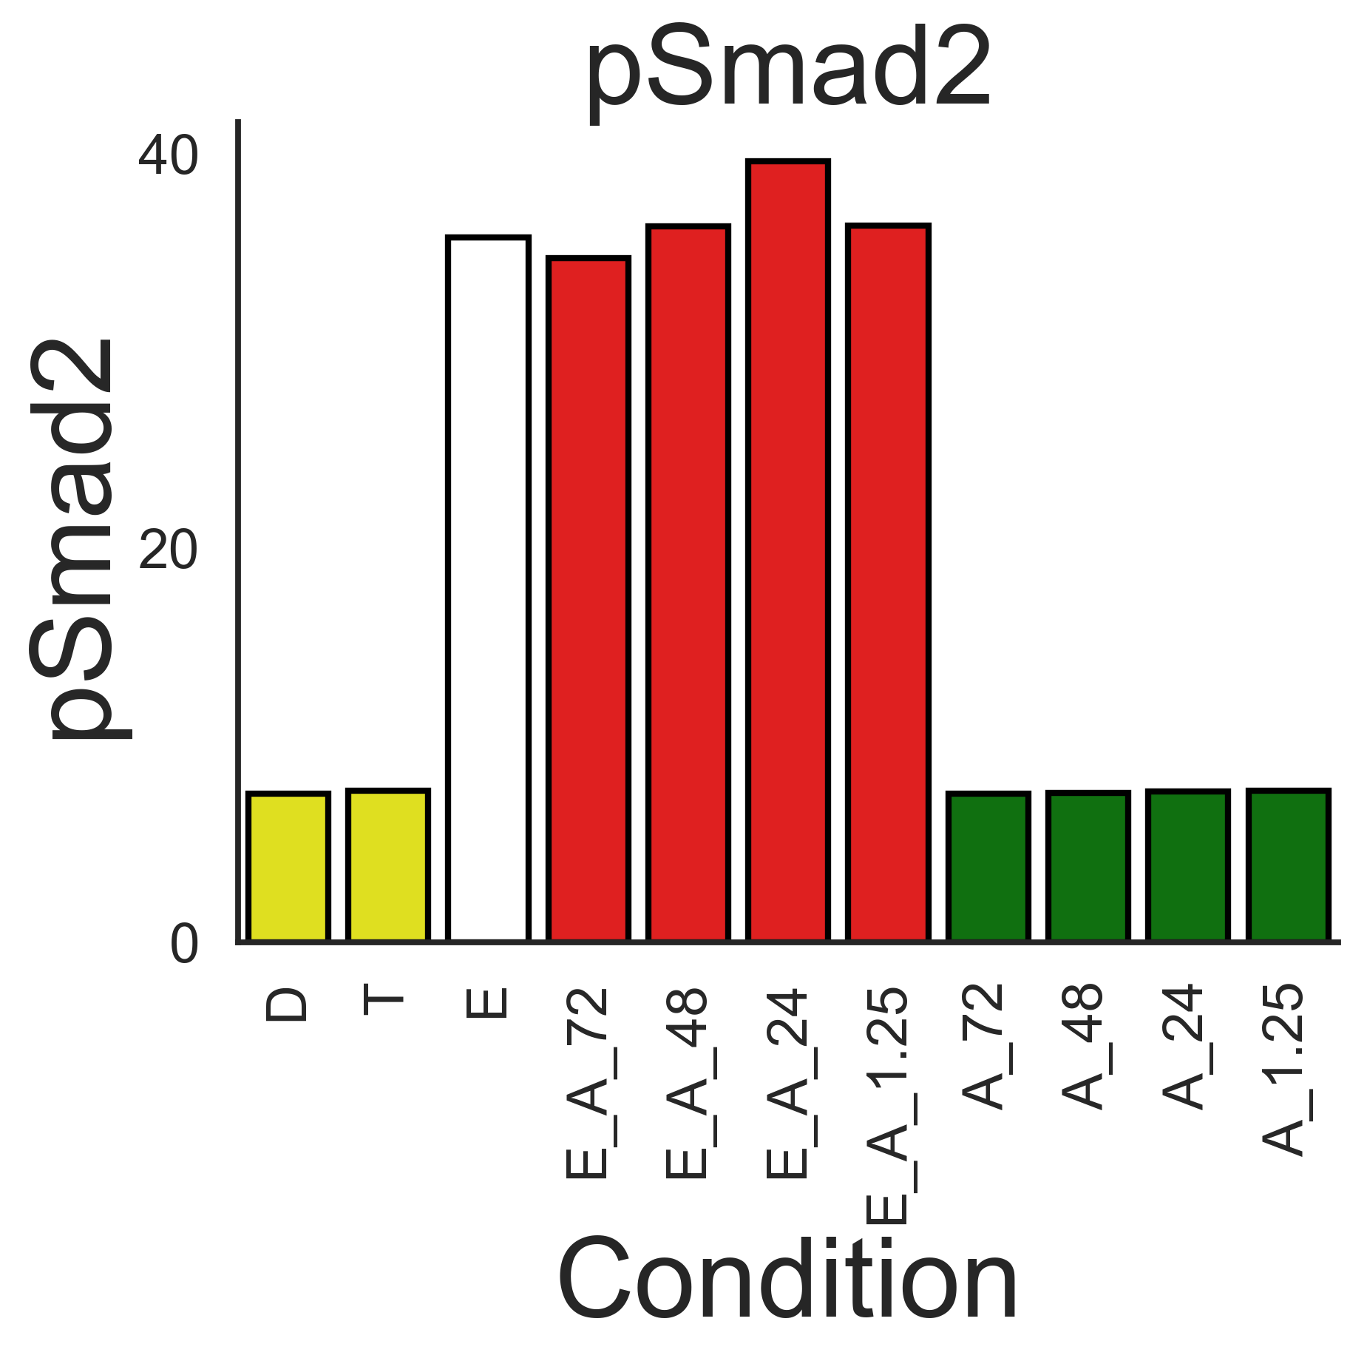
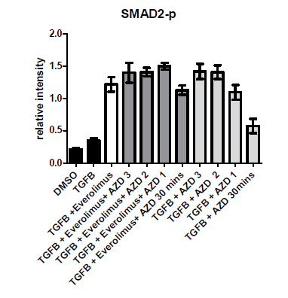
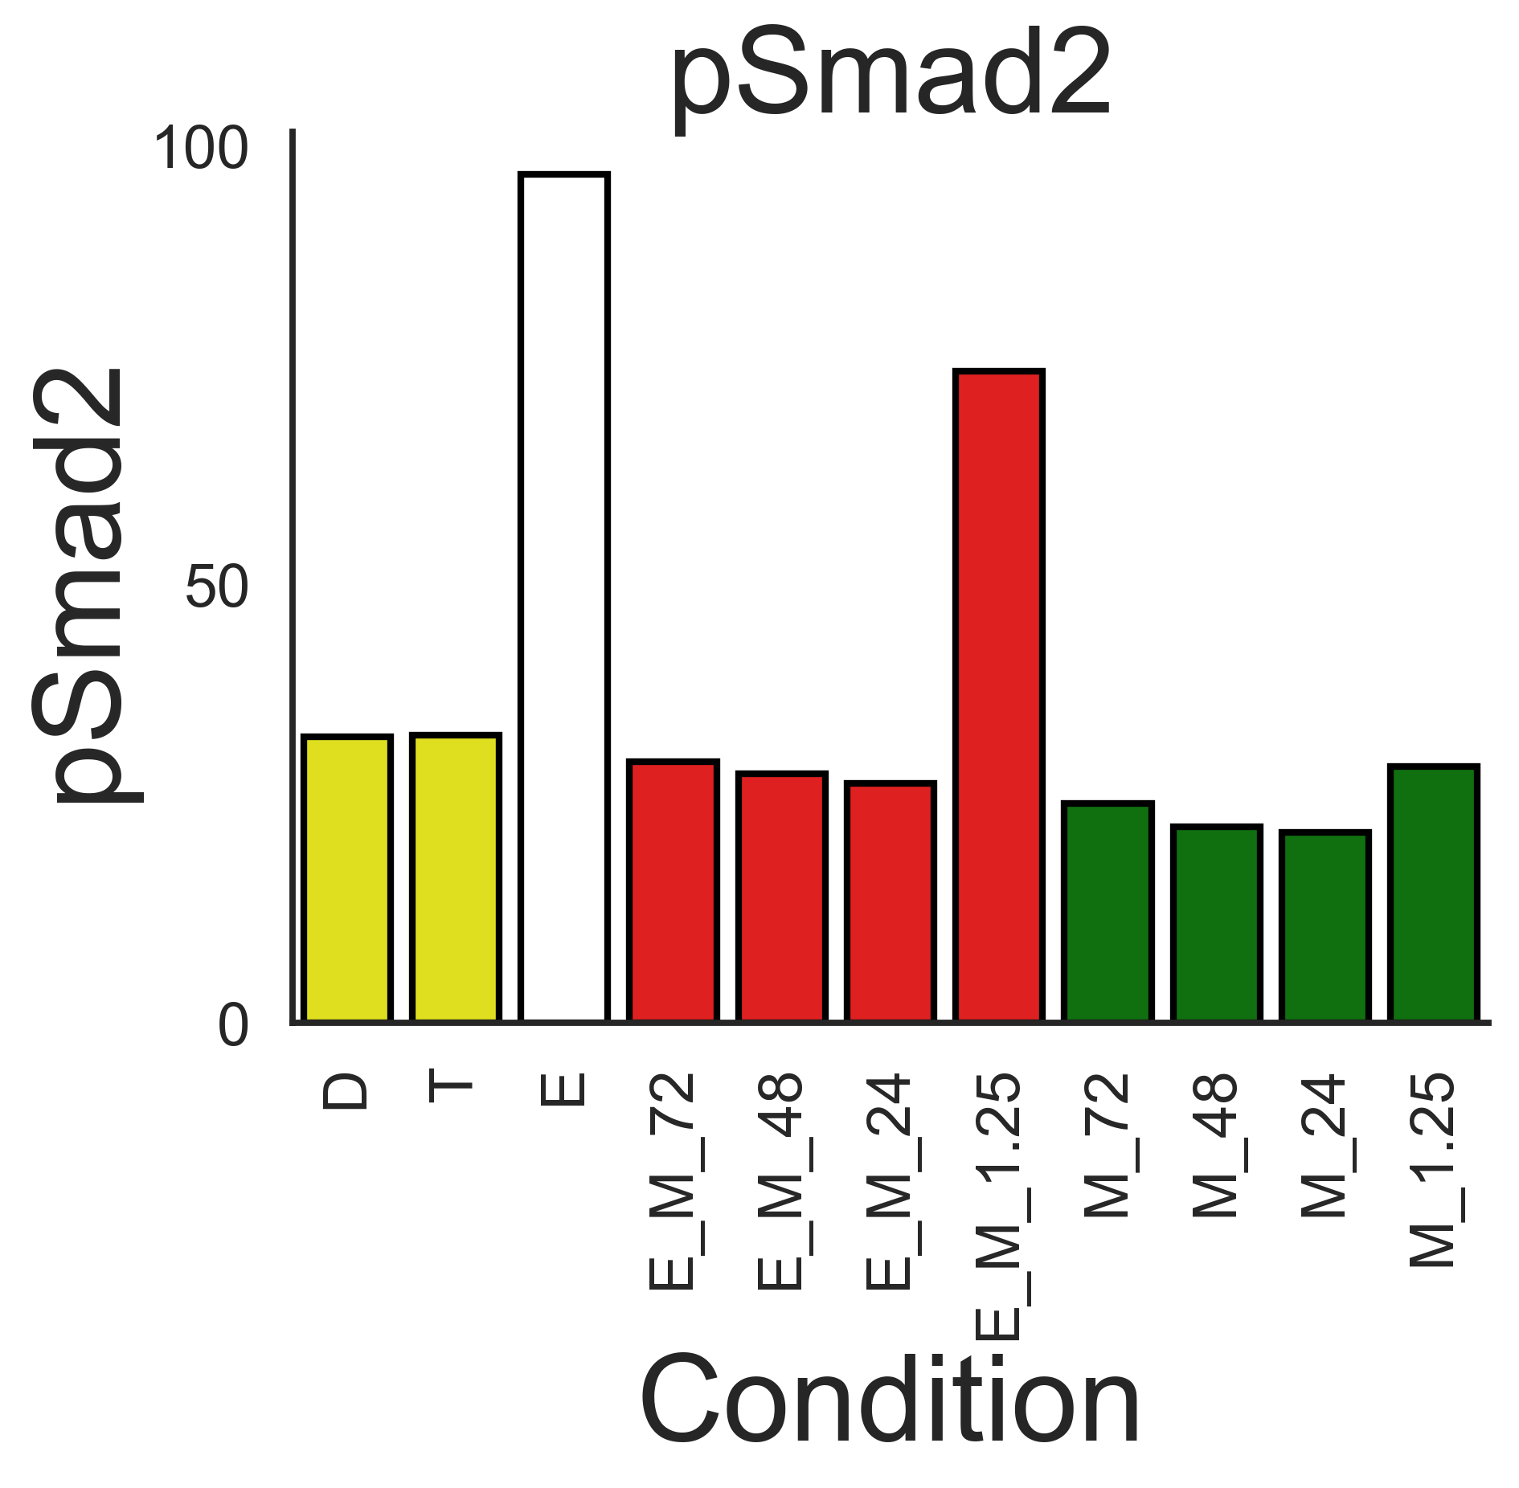
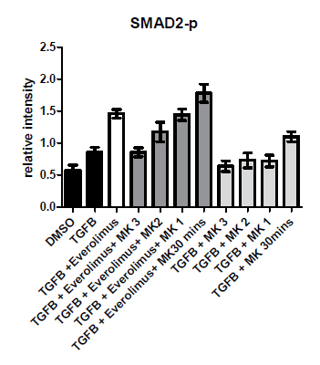
pSmad2
Experimental
Simulation
AZD
MK2206

Slide 9
Topology 2
Note: this is the same as previous, topology

Slide 10
Smad2 Interpretation
AZD
Everolimus pretreatment enhances TGFb-mediated phos of Smad2
AZD pretreatment also enhances TGFb-mediated phos of Smad2
Thus this must be by a different mechanism
When Everolimus and AZD are added together there is a small synergistic effect, specifically in the second two bars (compare E_A_1.25 Vs A_1.25 and E_A_48 Vs A_48).
However, it appears there is a non-linearity as maximal level of phos may be saturating (looking at E_A_48, E_A_72, A_48 and A_72)
MK2206 pretreatment transiently increases TGF-mediated Smad2 phos
But reasonably short lived <24h
Everolimus extends the transient phase of MK2206 mediated increase in Smad2 phos
MK2206

Slide 11
Some questions
AZD
How does Everolimus increase TGFb-mediated phos of Smad2?
How does AZD increase TGFb-mediated phos of Smad2?
How do Everolimus and AZD synergise in the increase TGFb-mediated Smad2 phos?
MK2206

Slide 12
Hypothesis 1: Akt phosphorylates an intermediate which leads to increase in Smad2 phos
AZD
Questions
How does Everolimus increase TGFb-mediated phos of Smad2?
How does AZD increase TGFb-mediated phos of Smad2?
How do Everolimus and AZD synergise in the increase TGFb-mediated Smad2 phos?
Answers
Under the assumptions that topology and hypothesis 1 is correct
If this is the mechanism then Everolimus increases TGF-mediated Smad2 phos by increasing pAkt
AZD inhibits Mek, which inhibits Erk which causes dephos of PI3K which lowers Akt phos and therefore Smad2 phosphorylation.
i.e. this hypothesis leads me to predict Smad2 would be dephosphorylated by AZD
This prediction is reflected in current simulations
Because of point 2), this hypothesis does not lend itself to synergy between AZD and Everolimus mechanism of enhanced TGFb-mediated Smad2 phos
Side note
It may be that the links between MAPK and PI3K are not accurately represented, in which case this can still be the correct hypothesis. For instance, removing the dephos reaction by ppErk may help with reproducing the Smad2 behavior. But at present, this reaction is responsible for being able to fit the pErk data for Everolimus
MK2206

Slide 13
Hypothesis 2: Erk phosphorylates an intermediate which leads to increase in Smad2 phos
AZD
Questions
How does Everolimus increase TGFb-mediated phos of Smad2?
How does AZD increase TGFb-mediated phos of Smad2?
How do Everolimus and AZD synergise in the increase TGFb-mediated Smad2 phos?
Answers
Under the assumptions that topology and hypothesis 2 is correct
Everolimus enhances pPI3K phos which phos Raf then Mek and Erk. Increased Erk increases pSmad2.
Inhibition of Mek leads to reduced Erk phos and subsequently would reduce Smad2 phos.
Similar to hypothesis 1, because of point 2) this hypothesis does not lend itself to the idea ofsynergy between AZD and Everolimus mechanisms.
MK2206

Slide 14
Hypothesis 3: Both pAkt and pErk are capable of independently phosphorylating Smad2
AZD
Questions
How does Everolimus increase TGFb-mediated phos of Smad2?
How does AZD increase TGFb-mediated phos of Smad2?
How do Everolimus and AZD synergise in the increase TGFb-mediated Smad2 phos?
Answers
Under the assumptions that topology and hypothesis 3 is correct
Everolimus enhances Akt phosphorylation. Akt phosphorylation increases Smad2 phosphorylation.
AZD inhibits Mek phos leading to less Erk phos, causing less phosphorylation of Smad2
same as for hypothesis 2, point 3.
MK2206

Slide 15
Hypothesis 4: pAkt leads to pSmad2 phosphorylation while pErk leads to inhibition of pSmad2 phos.
AZD
Questions
How does Everolimus increase TGFb-mediated phos of Smad2?
How does AZD increase TGFb-mediated phos of Smad2?
How do Everolimus and AZD synergise in the increase TGFb-mediated Smad2 phos?
Answers
Under the assumptions that topology and hypothesis 4 is correct
Everolimus enhances Akt phosphorylation. Akt phosphorylation increases Smad2 phosphorylation.
AZD inhibits Mek phos leading to less Erk phos, causing more phosphorylation of Smad2
Mechanistically could be increase of the rate of Smad2 phos or decrease of Smad2 dephos. I think we would not be able to distinguish.
It looks like mechanisms 1 and 2 would synergise.
This is my favorite hypothesis so far
MK2206

Slide 16
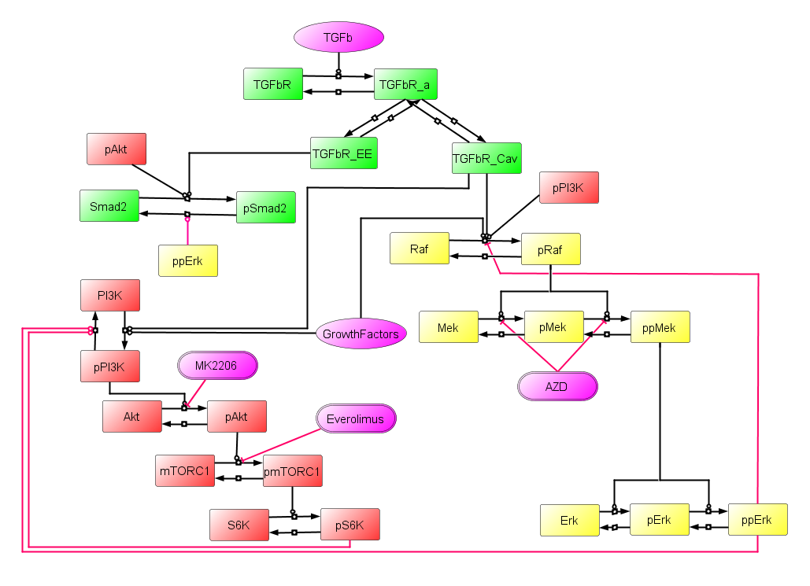
Topology 3. Adding ppErk inhibiting Smad2 phos

Slide 17
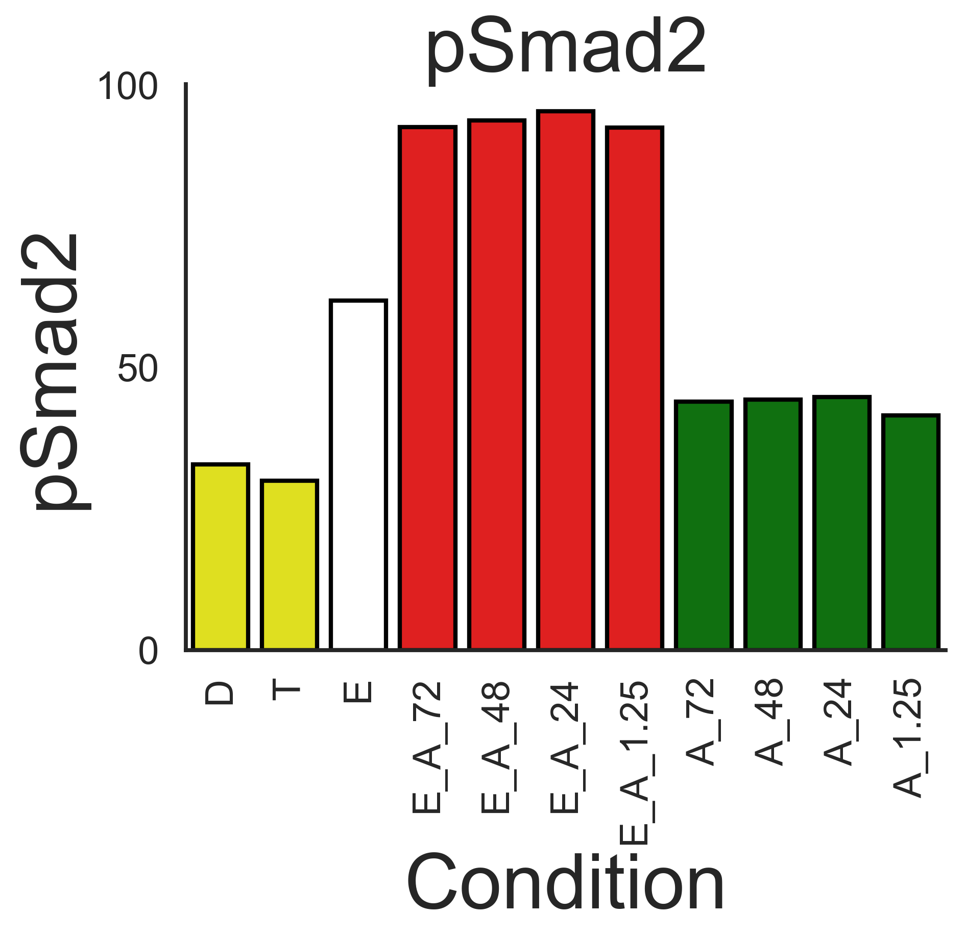
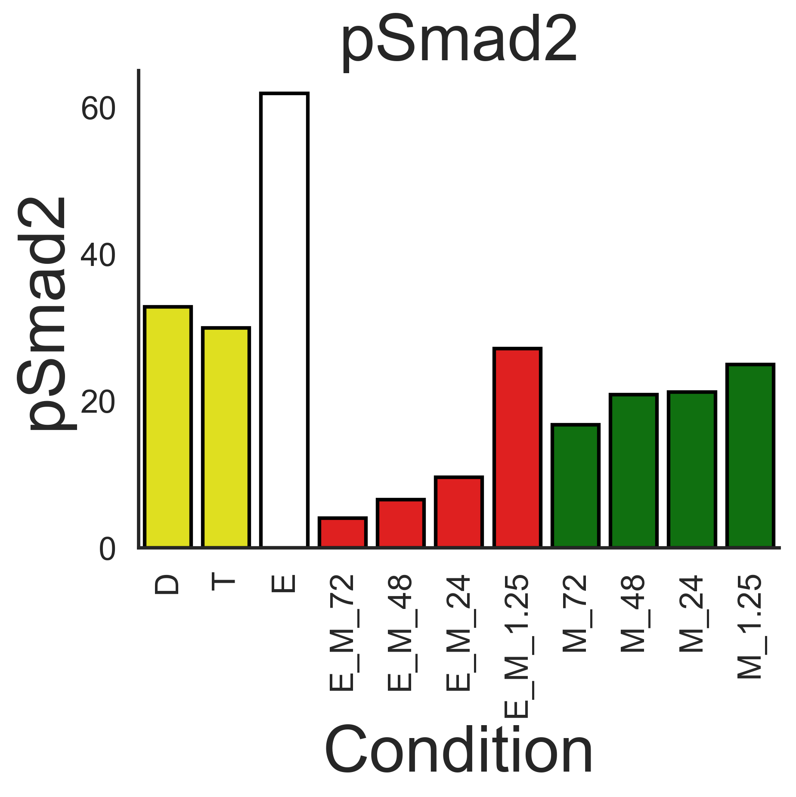
Smad2 simulations
Note – This is without adequate parameter fiddling, so still may be able to get better results.
Simulations with topology 2
Simulations with topology 3
AZD
I was expecting to be able to increase pSmad2 under AZD conditions
But ended up producing the graduated pattern in the MK2206 data
MK2206

Slide 18
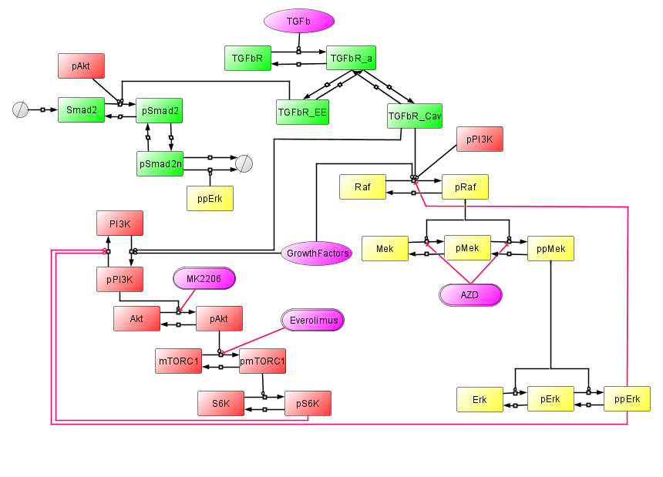
Topology 4
AZD
MK2206

Slide 19
Version Control
Date Committed | Branch | Comments | Git ref
18-12-2018 | Akt | This is the model version that simulated the graphs in slides 4 – 8. | e08c385cd54d24f0c1944f6dc6f1ed78be6de0cd

